Slide 1
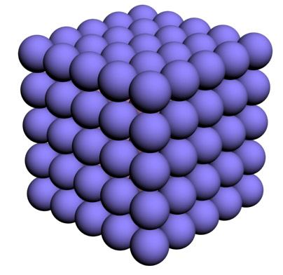
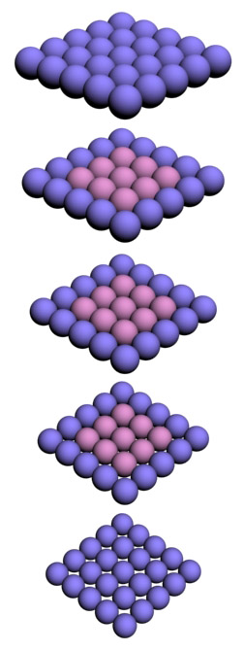
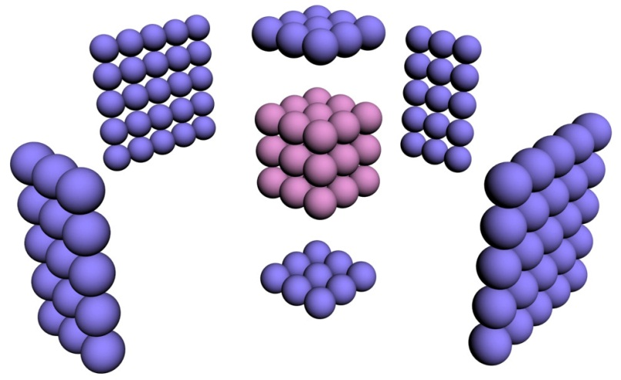
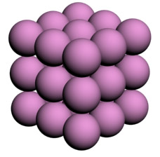
Faces are key to behaviour

Slide 2
Considering Hydrogen atom (radius = 0.05 nm)
n (atoms on edge) | N = n³ (total atoms) | % atoms on surface | Size of cube
10⁷ | 10²¹ | 0.00006 | 1 mm
10⁴ | 10¹² | 0.06 | 1 μm
500 | 125x10⁶ | 1.2 | 50 nm
100 | 10⁶ | 5.8 | 10 nm
10 | 10³ | 50 | 1 nm
5 | 125 | 80 | 0.5 nm

Slide 3
Can you figure out the formula?
For n atoms solid structure, it should be:
Total: n^3
Below surface: (n-2)^3
On the surface: n^3 – (n-2)^3
For n=100
On the surface = 58808
Hence % = 5.8%

Slide 4
In bulk systems (observed at meter till micron level) atoms appearing on the surface are too small in number or percentage and so bulk atoms dominate in governing almost all the properties. Whereas in nano systems (in the range of 100 – 1 nm) the percentage of surface appearing atoms change drastically (it can also be seen in terms of surface to volume ratio), hence these atoms play crucial role in controlling properties manifested at nanoscale.

Slide 5
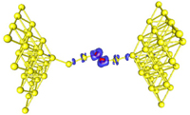
Bokwon Yoon and Uzi Landman, “Electric Field Control of Structure, Dimensionality, and Reactivity of Gold Nanoclusters on Metal-Supported MgO Films”, Phys. Rev. Lett., 100, 056102 (2008).

Slide 6
They reported that a metal-to-insulation transition might be found in gold on the nanoscale.
A gold nanowire containing 20 gold atoms embedded with oxygen molecule conducts whereas a reduced length of wire containing only 6 gold atoms becomes an insulator. They also predicted that when individual oxygen atoms, rather than an oxygen molecule were incorporated in the gold nanowire, magnetic properties emerged at nanoscale when their bulk form doesn’t have those properties.

Slide 7
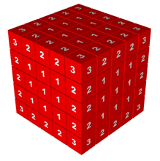
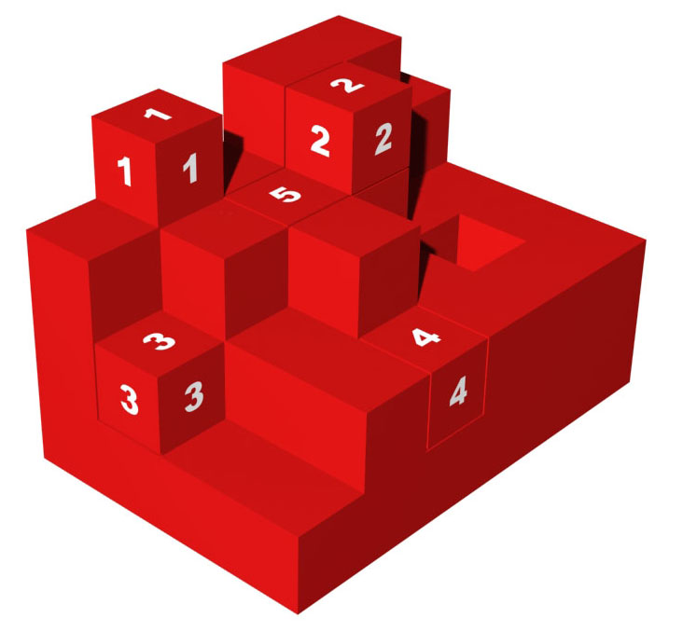

Slide 8
Exploring Nano:
a Pedagogical Journey

Slide 9


Sunscreen Lotion
Titanium oxide
Zinc oxide

Slide 10
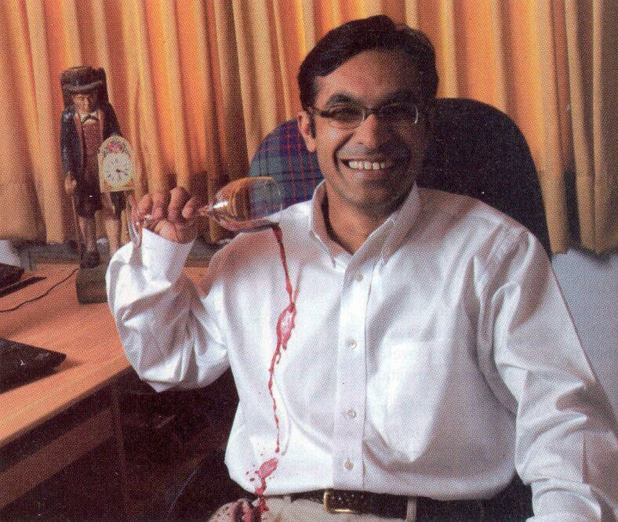
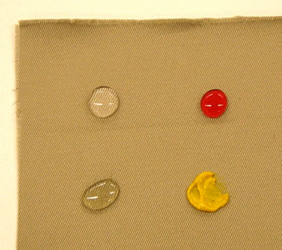
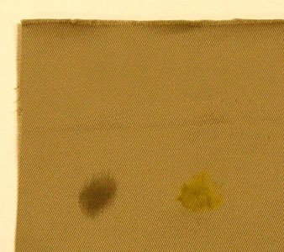
Stain free,
Water resistant fabric

Slide 11
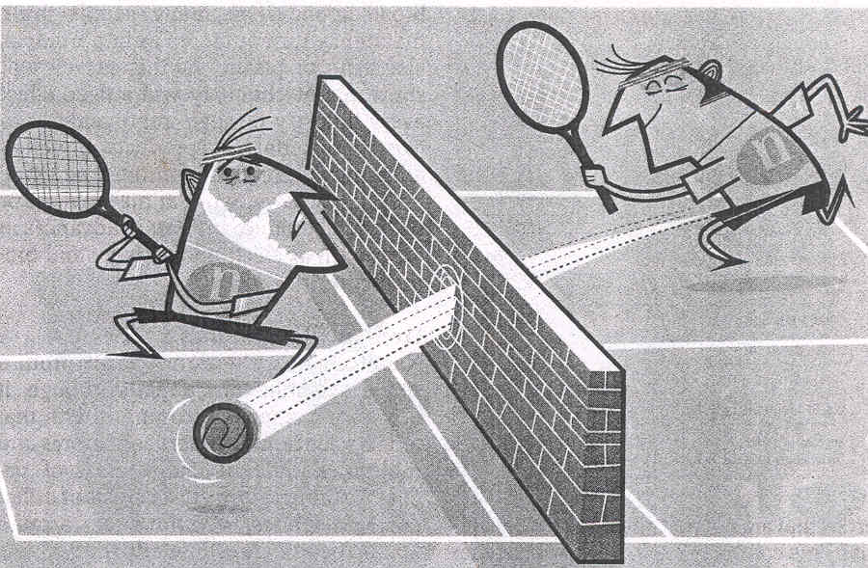
Expect the Unexpected

Slide 12
What is Nanotechnology?

Slide 13
Understanding Effects
Centimeter: Gravity, friction, combustion
Millimeter: Gravity, friction, combustion, electrostatic
Micrometer: Electrostatic, van der Walls, Brownian
Nanometer: Electrostatic, van der Walls, Brownian, Quantum
Angstrom: Quantum mechanics
(1/10,000,000,000 meter)

Slide 14
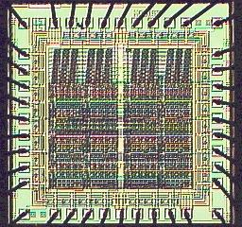
Nanotechnology is all about
Arranging Atoms
Do you recognize this structure?
Diversity
Precision
Cost

Slide 15
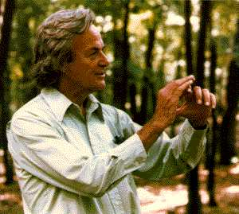
Richard Feynman,1959
(the great visionary)
There’s plenty of room
at the bottom

Slide 16
The principles of Physics, as far as I can see, do not speak against the possibility of maneuvering things atom by atom.
Richard P. Feynman

Slide 17
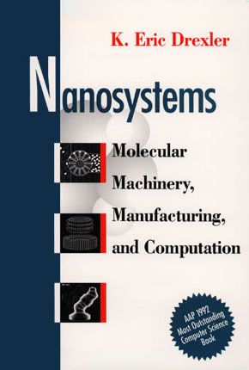
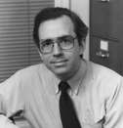
Eric Drexler, 1992
(the great pioneer)

Slide 18
Nanotechnology is the principle of atom manipulation atom by atom, through control of the structure of matter at the molecular level. It entails the ability to build molecular systems with atom-by-atom precision, yielding a variety of nanomachines.
Eric Drexler

Slide 19
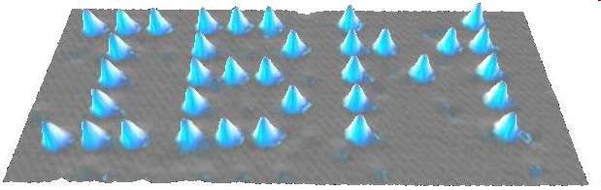
Manipulation Atom-by-Atom
IBM
35 Xe atoms put together on nickel
Don Eigler (IBM, California), 1989
Became the 1st person to move atoms

Slide 20
Nanotechnology is concerned with developing the tools for characterizing and manipulating materials on nanoscale (1-100 nm) and exploiting these tools for the development of new products and processes.

Slide 21
Narrow definition: at least 2 dim are below 100 nm
Extended definition: one dimension below 100 nm and a second dimension below 1 μm.

Slide 22
Nanostructure
Based on their geometrical dimension with reference to an external reference system, viz., substrate.
Nanodevice
At least one functional component is a nanostructure.
Nanosystem
Consists of several nanodevices that are of importance for the functioning of the whole system.

Slide 23

Advantages of
starting from “small things”
you can dissolve sugar or salt quicker when it is in powder form and slower when it is in the form of crystals or blocks
smaller can become more reactive

Slide 24
Advantages of
starting from “small things”
Properties can be altered as desired
More precision
Less waste

